Slide 1
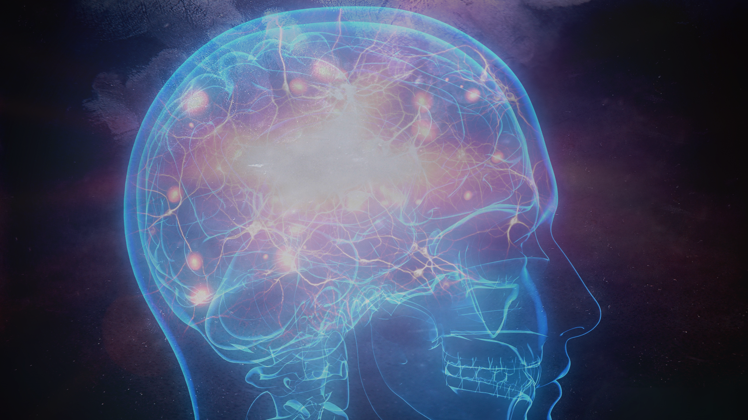
Presentation by Poonnawich Siriwongse Na Ayudhaya (G27)

Slide 2
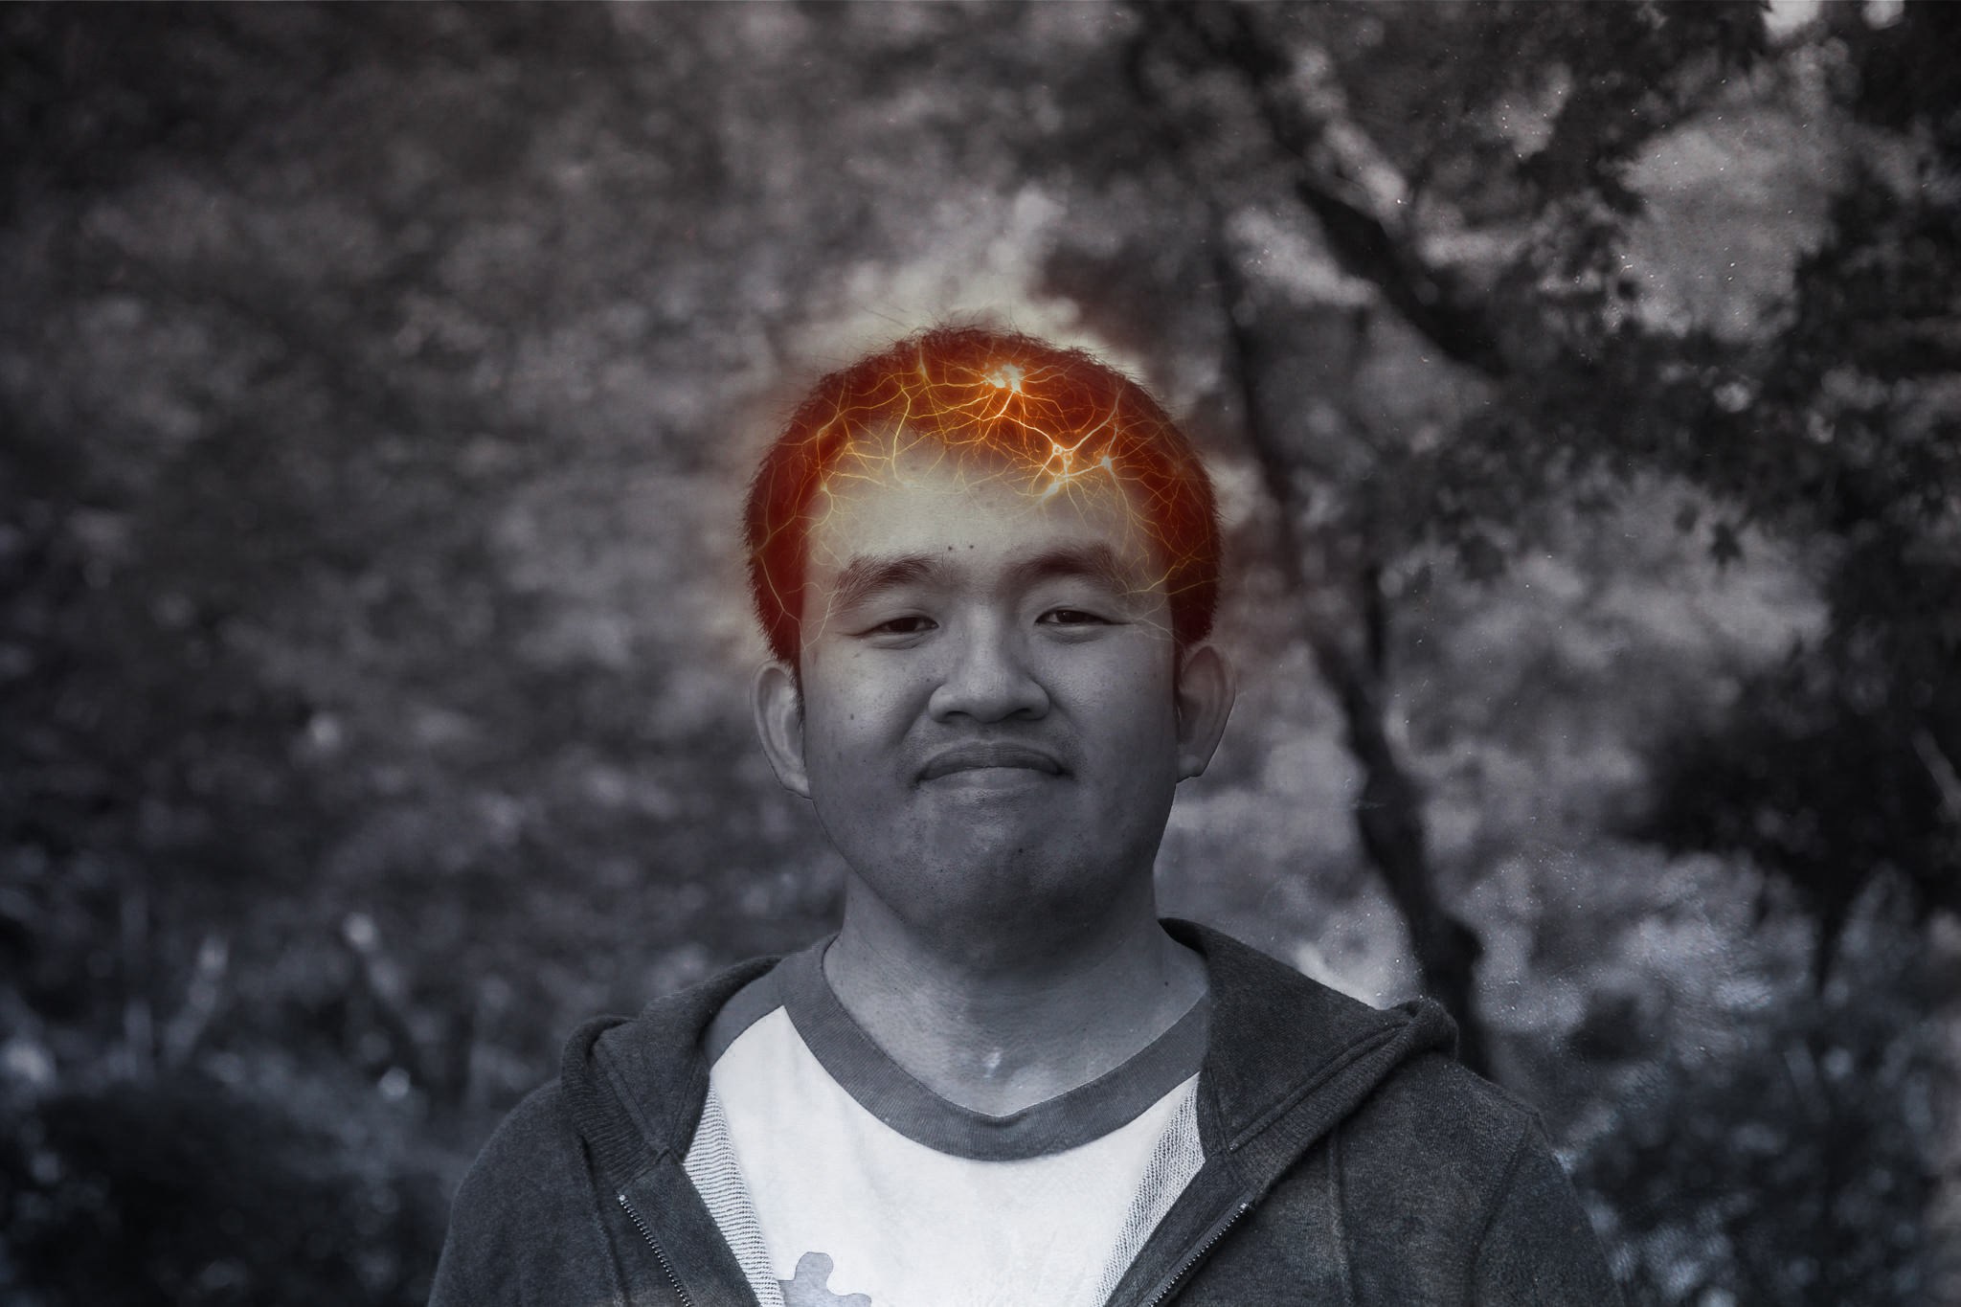
Asst. Prof. Dr. Cholwich Nattee

Slide 3
Contents
What is it?
What features it has?
With some short demo videos.
How does it work?
What issues did I come across?

Slide 4







What Is it?
A program which uses your facial expressions to output your current emotion.
Programmers & non-programmers
Visual
Text
Programmers

Slide 5

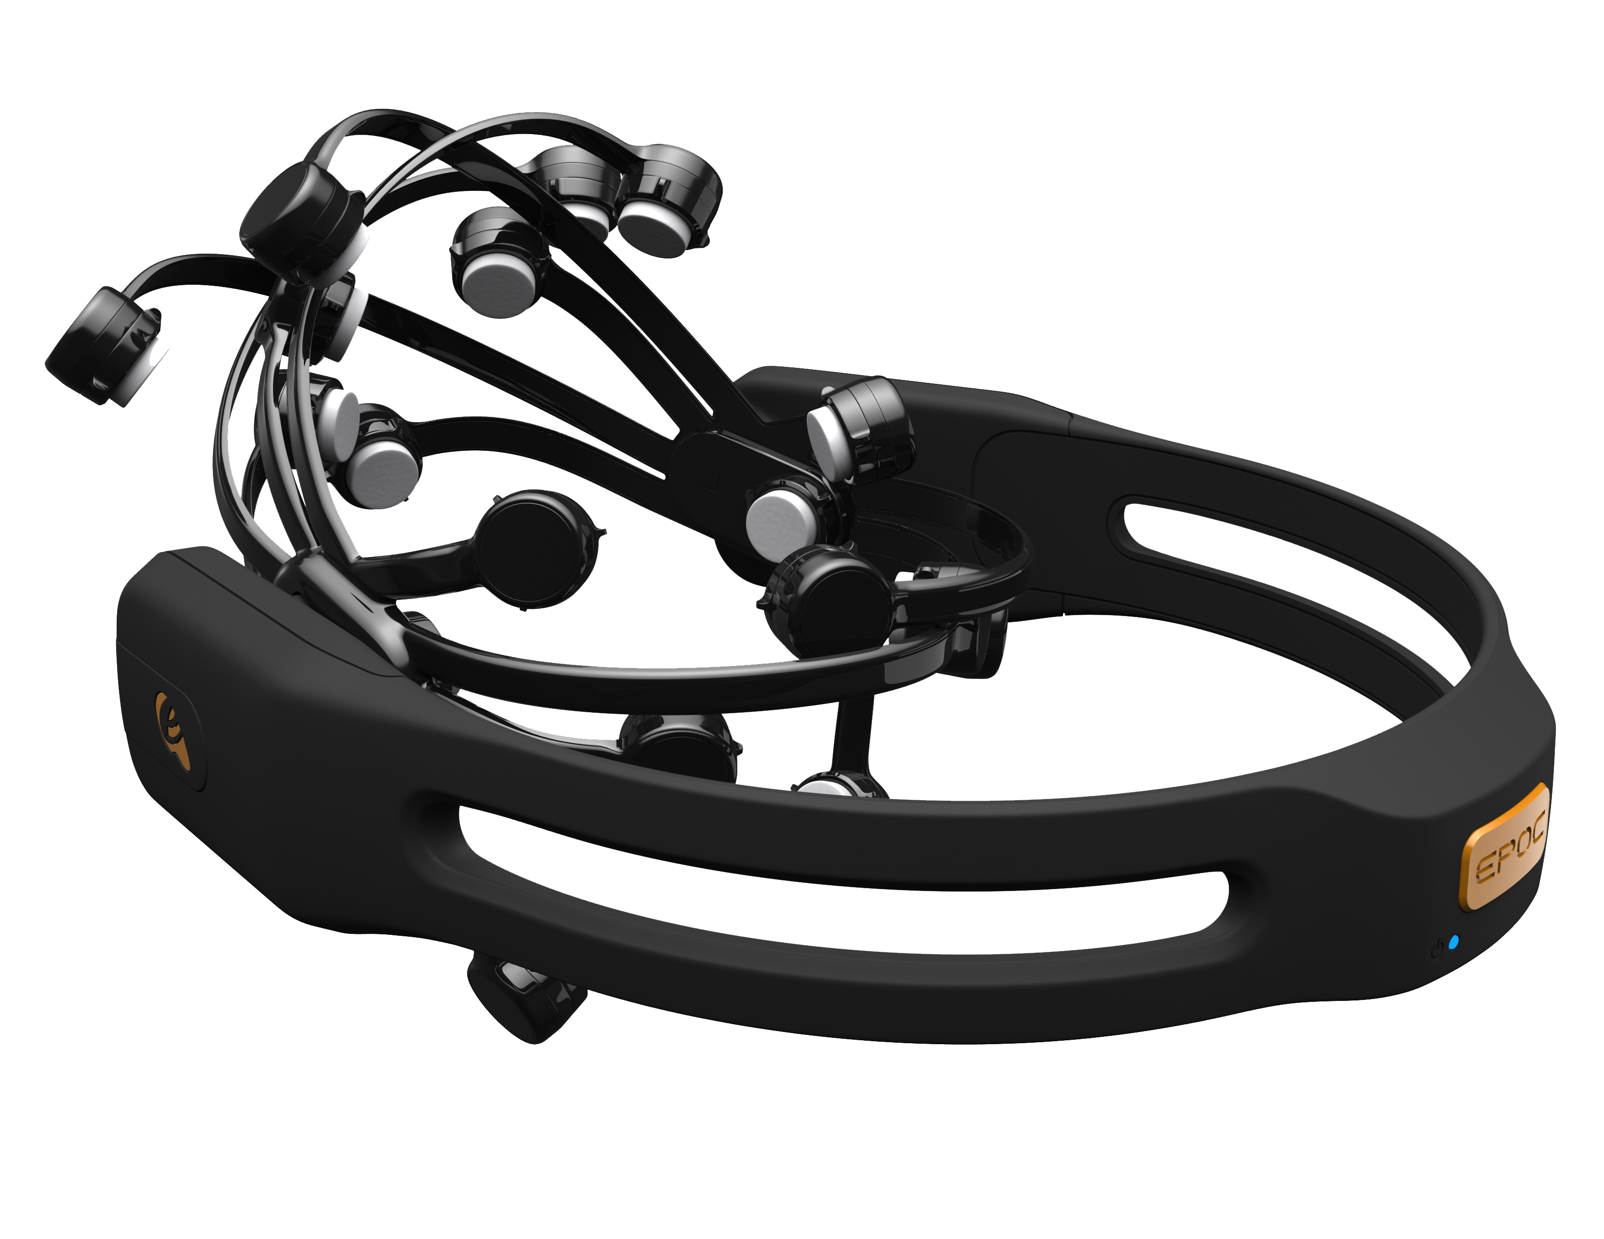

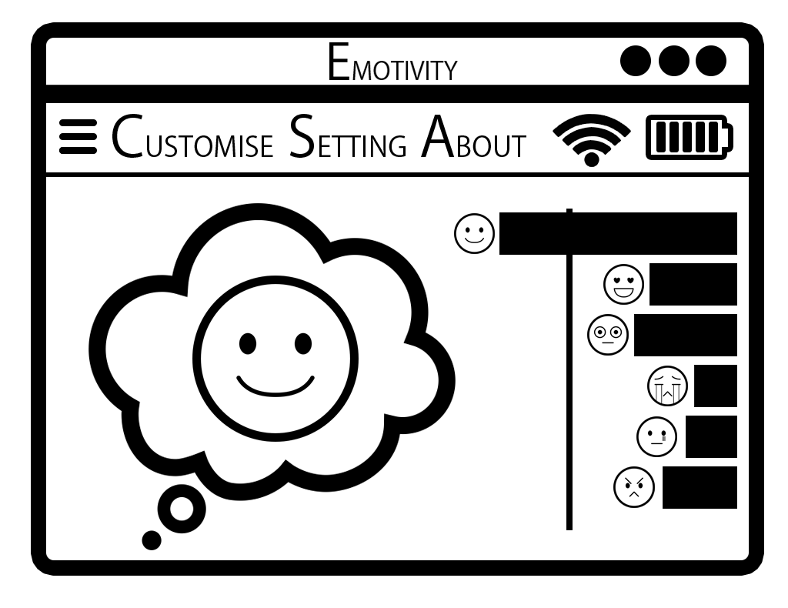
The Overall Picture
Emotivity’s Outputs
Emotiv EPOC
EmoEngine
(run-time library)
Emotivity
Raw Data
EmoState
(output that is easier to comprehend)
+ minor data
Output

Slide 6

Features
Output visualisation
Classification visualisation
Modifiers customisation
Program settings
Headset status display
Output and logs
Graphical user interface
User data management

Slide 7

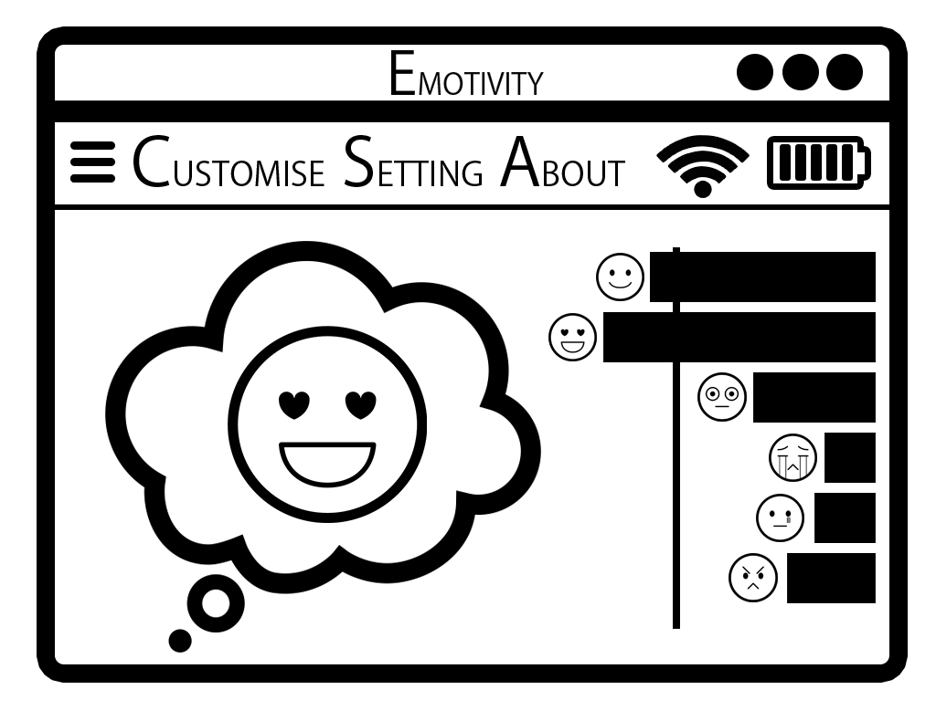
Output Visualisation
Shows the users the output emotion as a corresponding picture.

Slide 8
Classification Visualisation
Shows the users statistical emotion class values as bar charts.

Slide 9

Headset Status Display
Shows the users the headset’s signal strength and battery life.

Slide 10
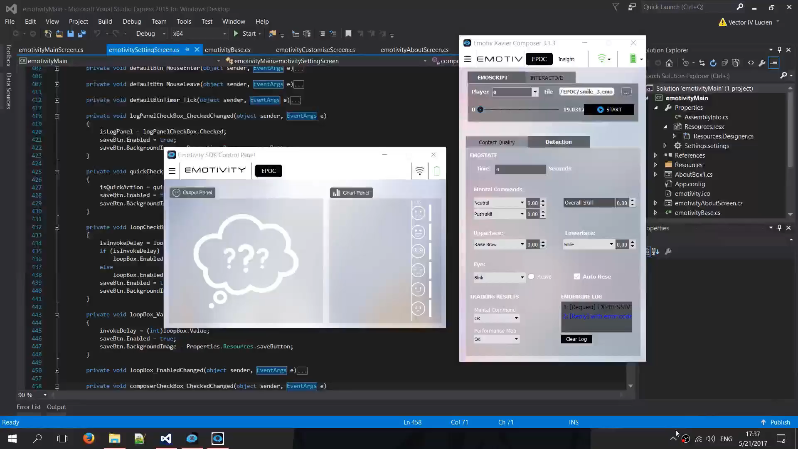
Core Features

Slide 11
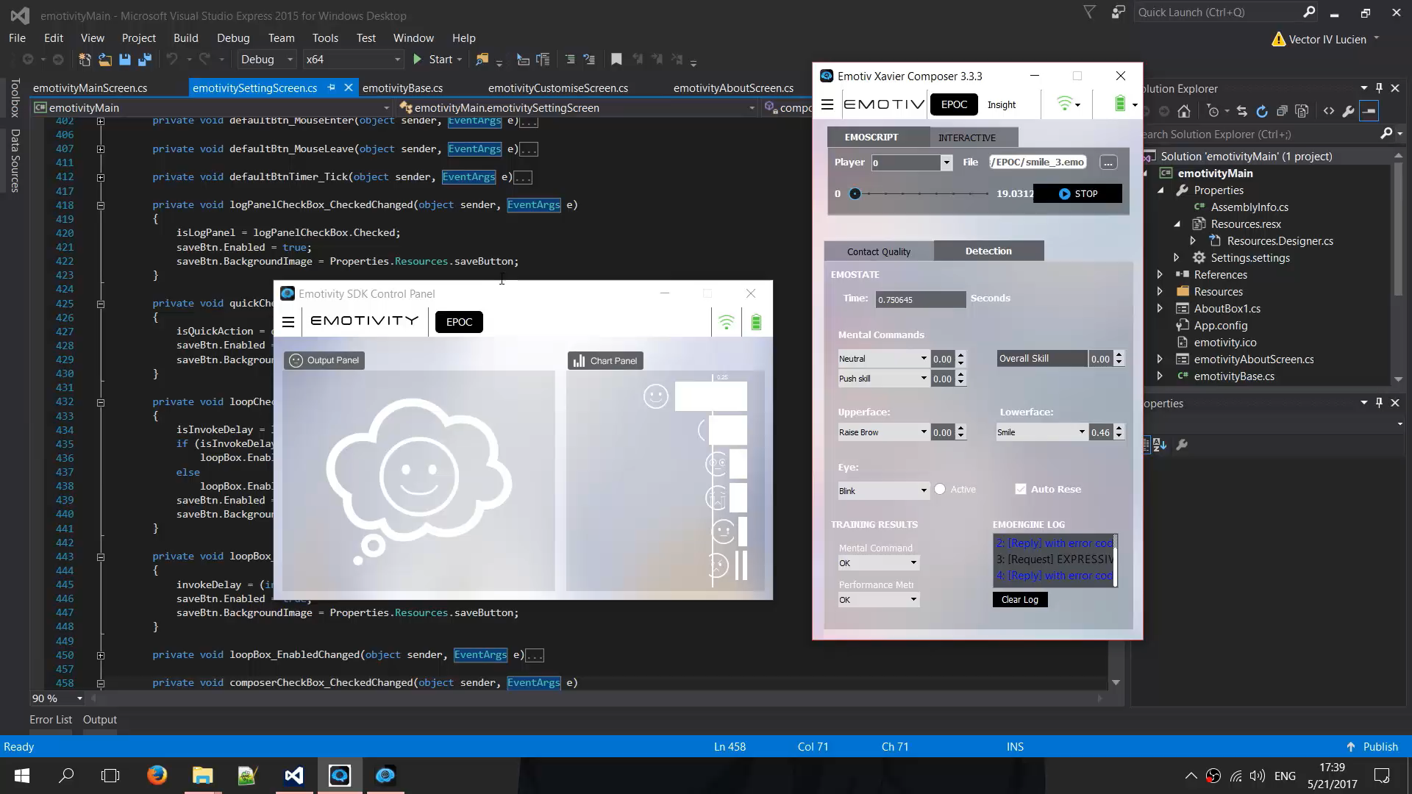
Tray Output Visualisation

Slide 12
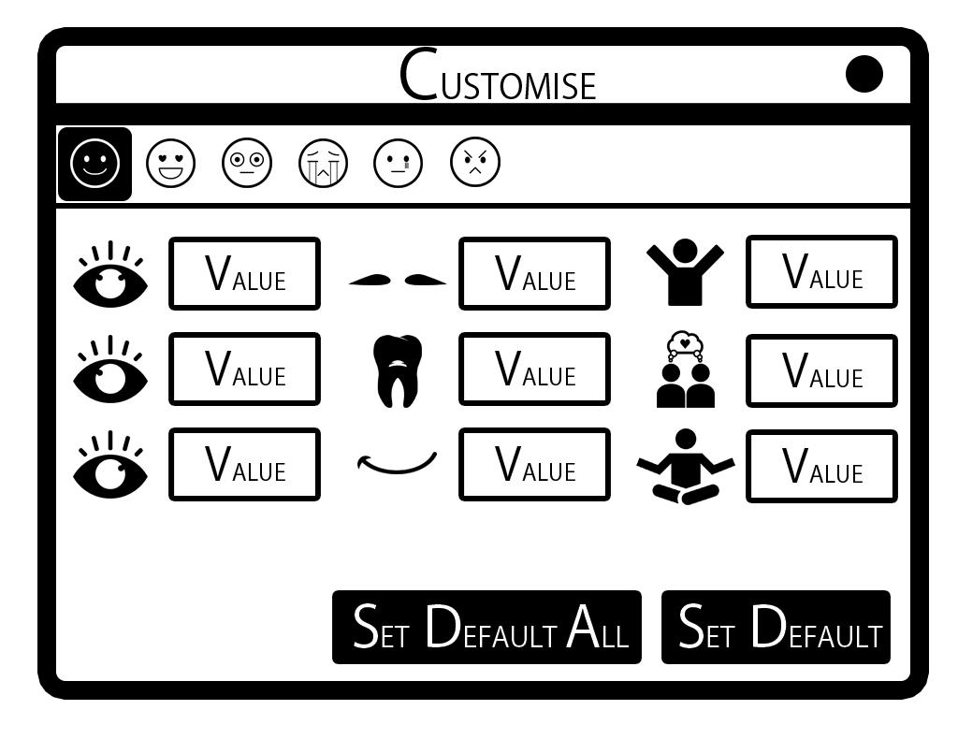
Modifiers Customisation
Allows users to change how each emotion class is determined.

Slide 13
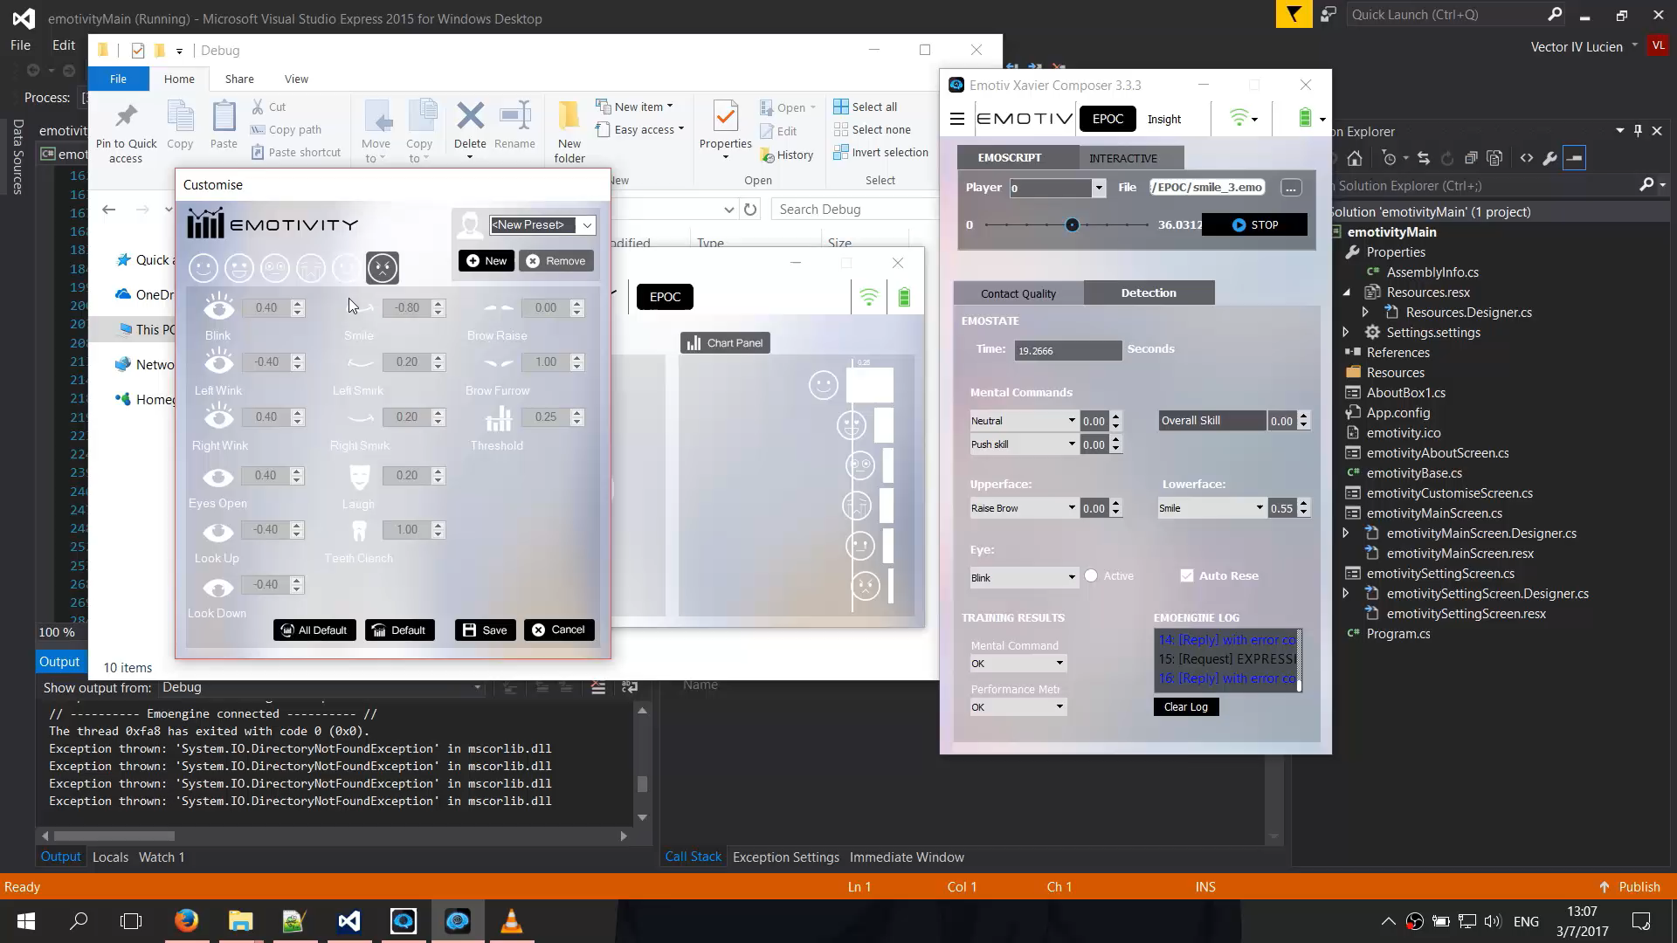
Modifier Customisation

Slide 14
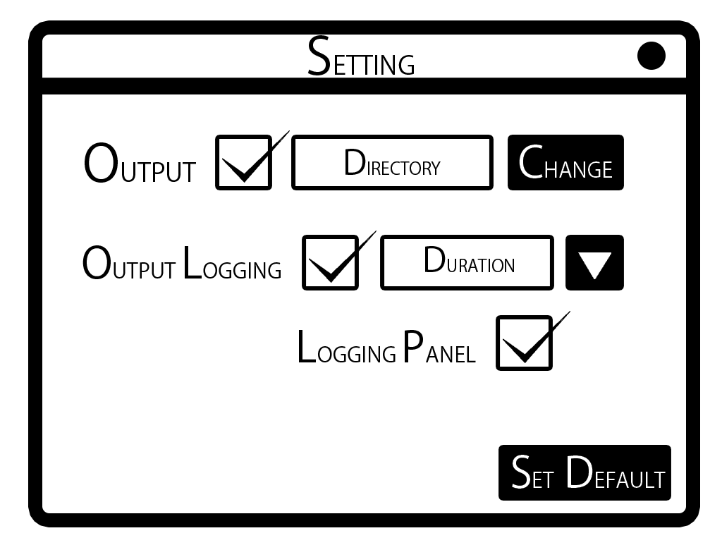
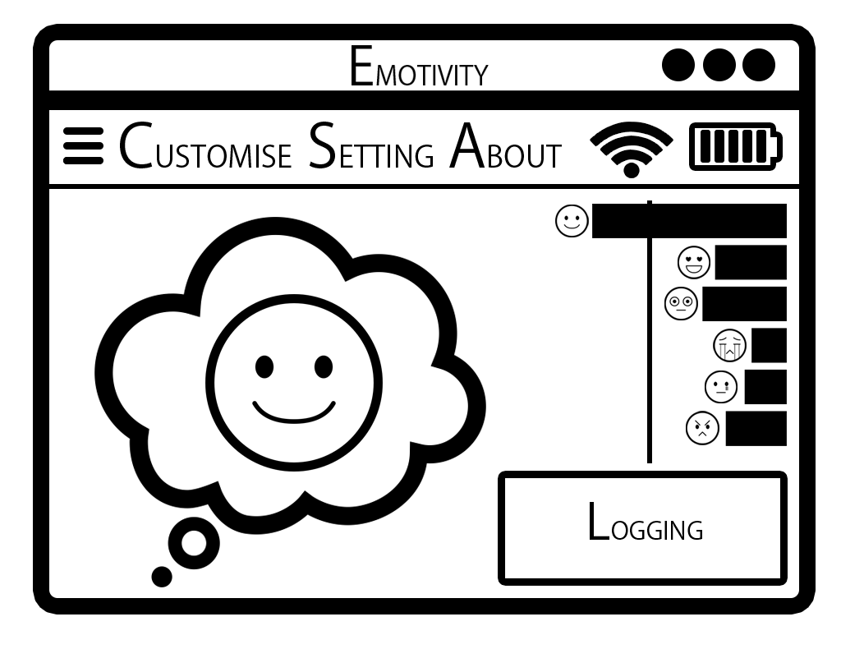
Program Settings
Allows users to activate extra functions, and alter how certain functions work.

Slide 15
Output & Logs
Allows users to retrieve the output and emotion class values as text and logs.

Slide 16
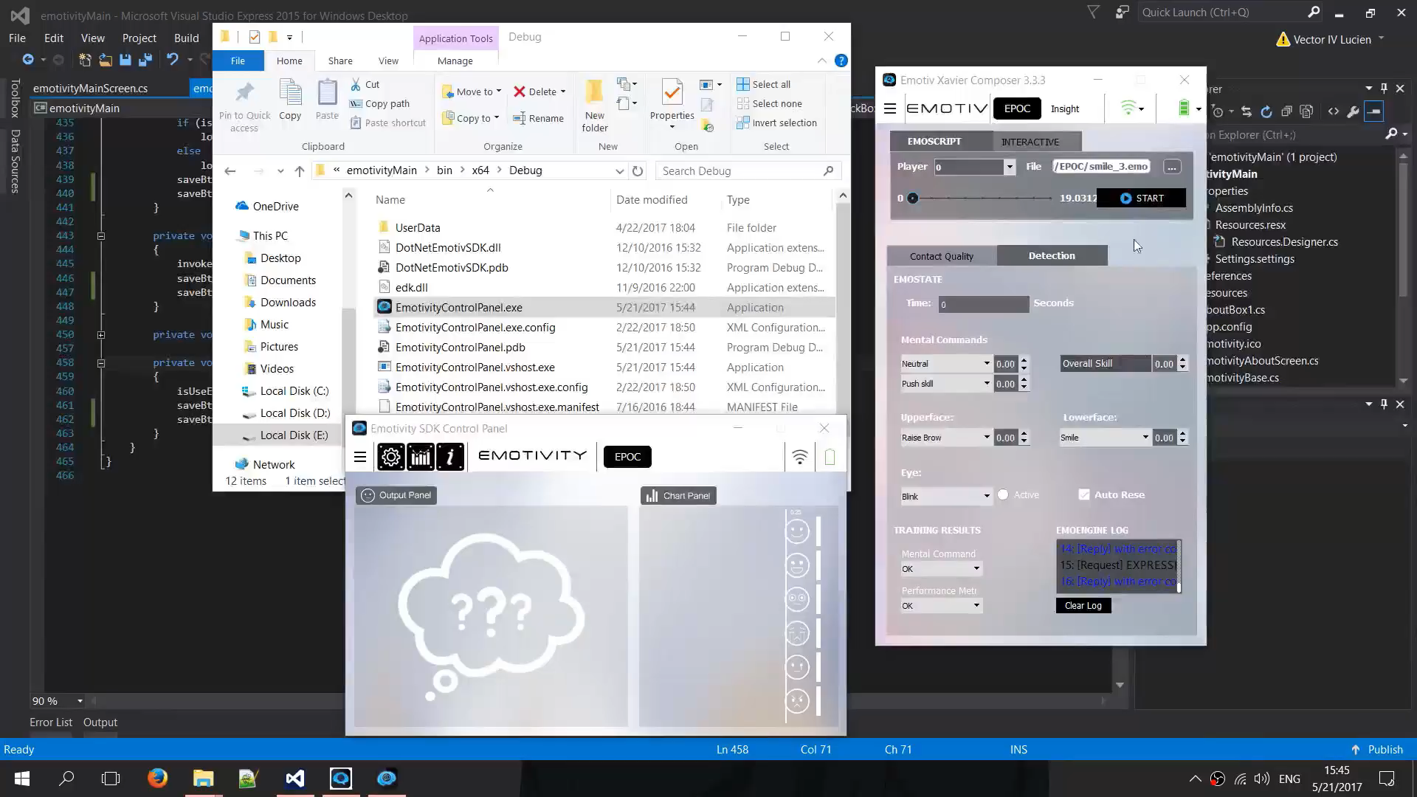
Outputting

Slide 17
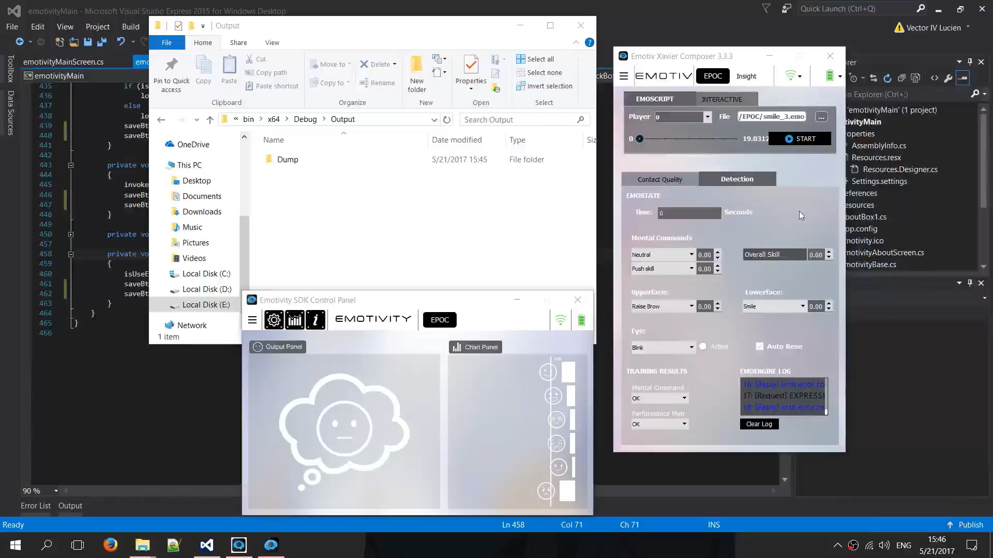
Logging

Slide 18
Program Settings
Allows users to change certain behaviours of the program.
These behaviours are as followed:
Text output
Logs output
Logs panel
Composer mode
Quick action
Invoke delay

Slide 19

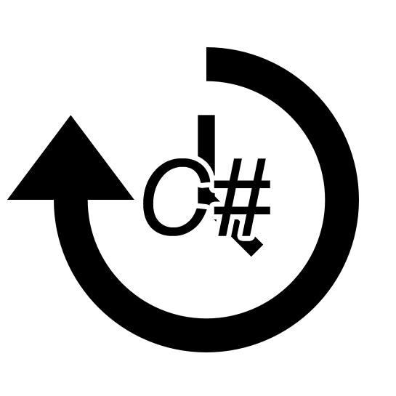
Program Settings
Quick action – allows for toggling of text output and logs from the main screen.
Invoke Delay – allows change in computation loop time.

Slide 20
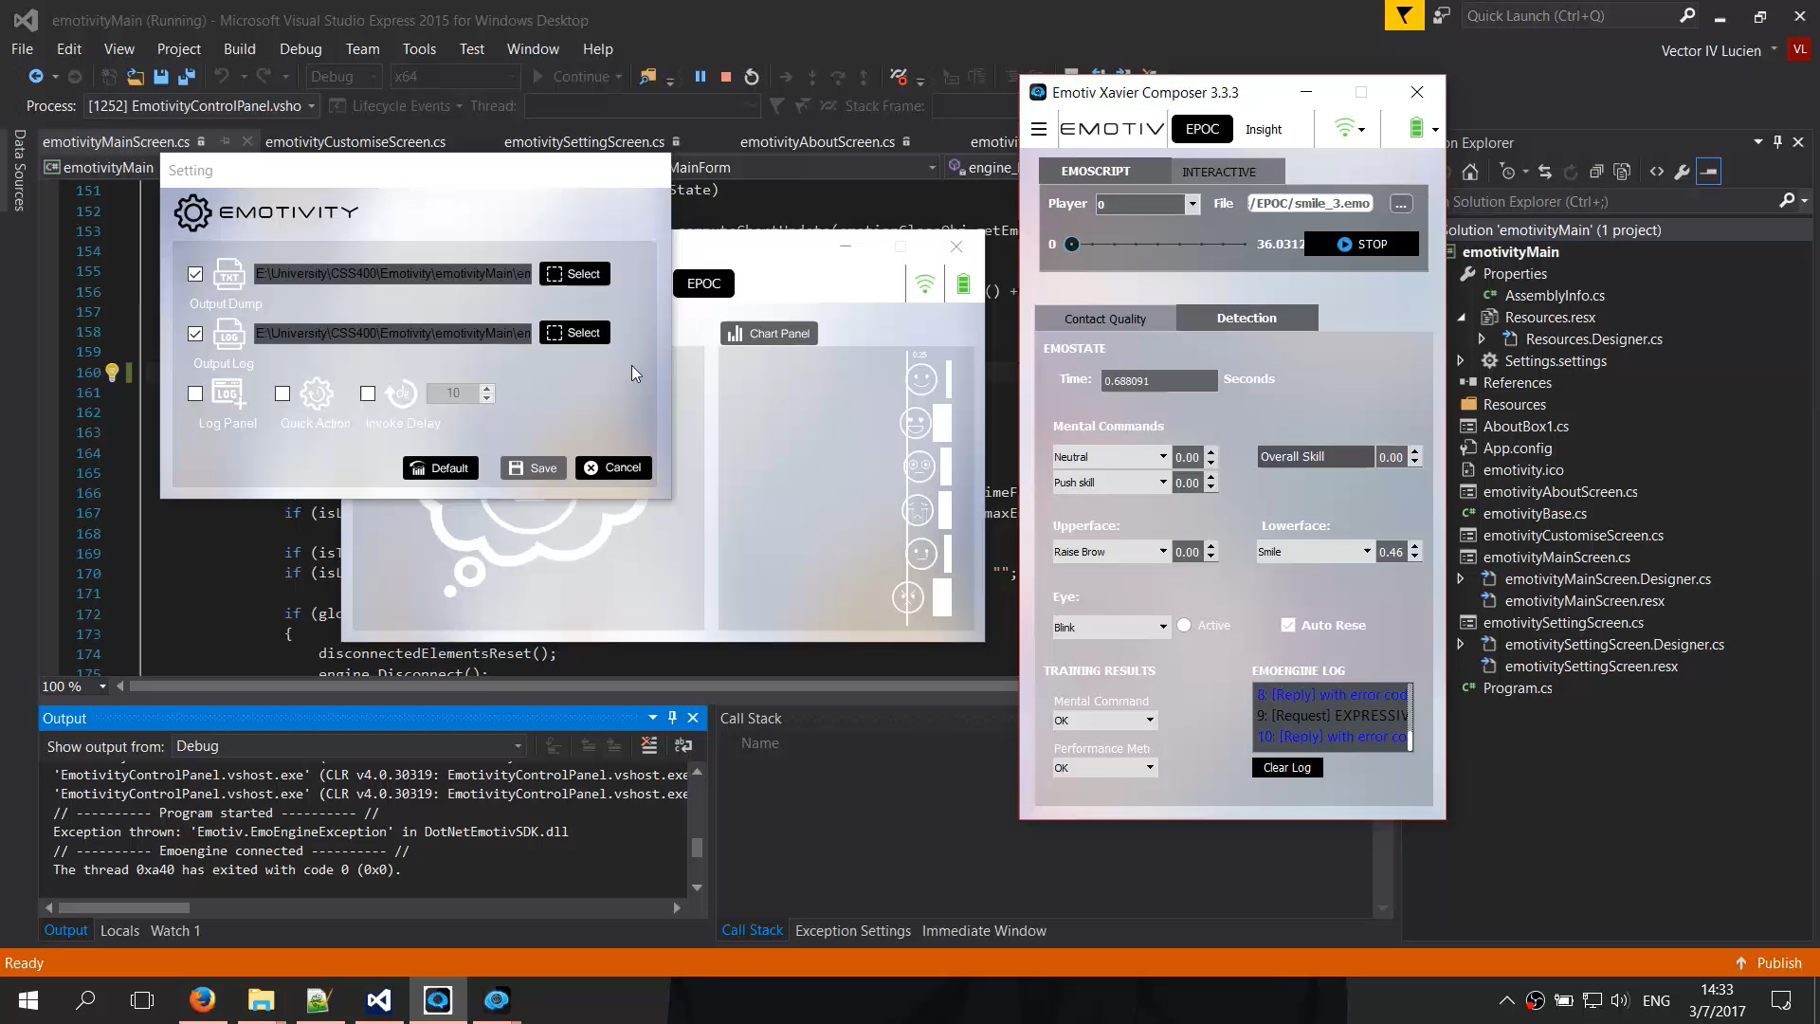
Logs Panel

Slide 21
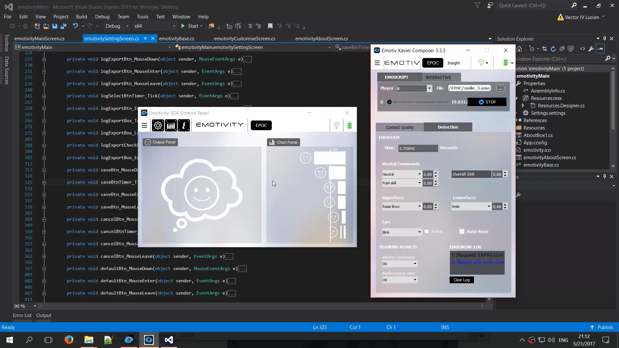
Composer Mode

Slide 22
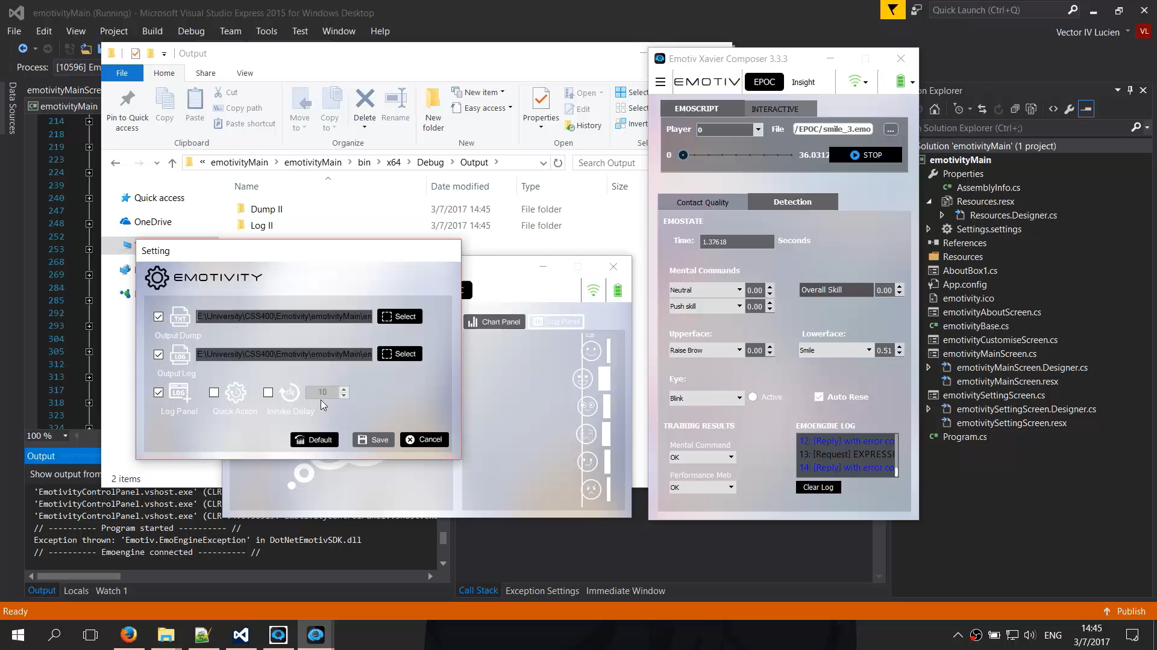
Quick Action

Slide 23
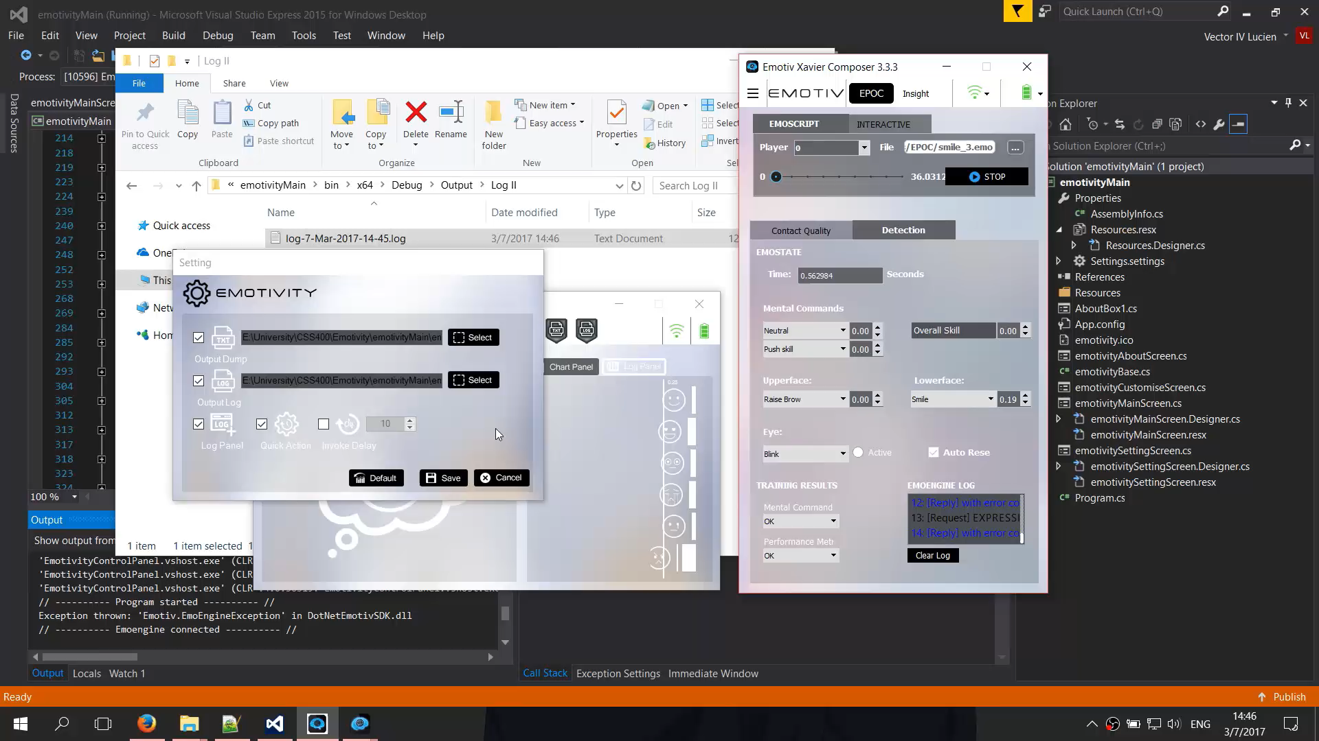
Invoke Delay

Slide 24
Graphical User Interface
Allows users to easily navigate through provided features.

Slide 25

User Data Management
Allows user data to be preserved and relocated.
Implemented using XML structure.

Slide 26
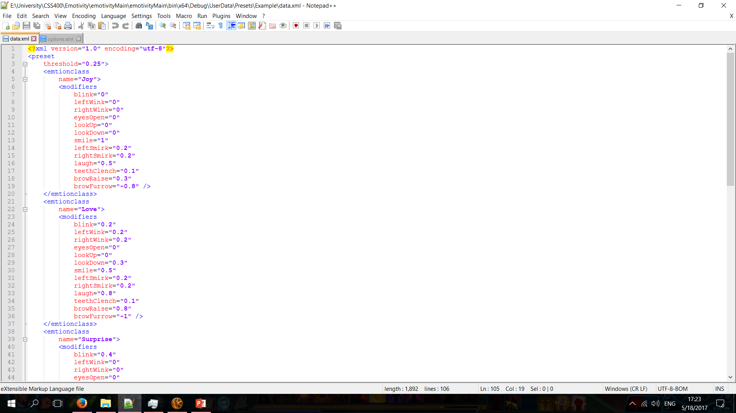
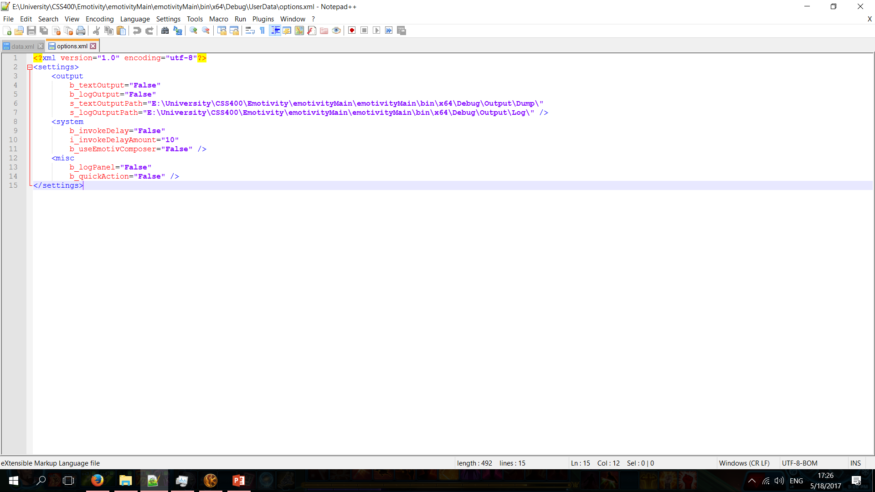
User Data Management

Slide 27

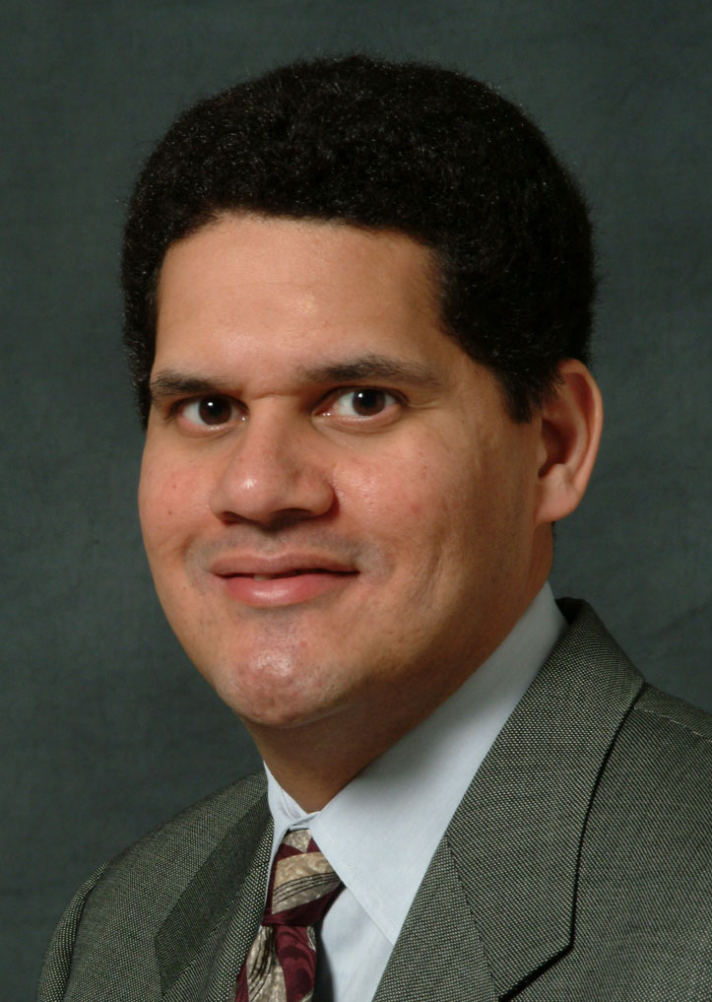


How Does it Work?
Emotion Class
1.0
0.2
[ ]
[ ]
(1.0 + 0.2 + 0.0) ÷ 2 = 0.6
1.0
x
1.0
# The divider is the number of non-zero values post-multiplying
0.0
0.0
User’s Face
EmoStates
Modifiers
Final Value

Slide 28



How Does it Work?
0.6
[ ]
MAX
0.2
> 0.15
0.6
0.0
Emotion Classes
Threshold
Output Value
Outputs

Slide 29
How Does it Work?
0.6
[ ]
0.2
0.0
Emotion Classes
Outputs

Slide 30
Issues
The headset is not as perfectly precise as the simulator (during most of the time.)
It is poorly designed.
This may distort the output when there are hiccups.

Slide 31
Issues
Missing modifiers: engagement, interest, meditation.
Unable to obtain SDK premium version.
Staff problems at the developer company.
Lack of a sufficient variety in EmoStates.
This makes some emotions very hard to be efficiently captured.

Slide 32
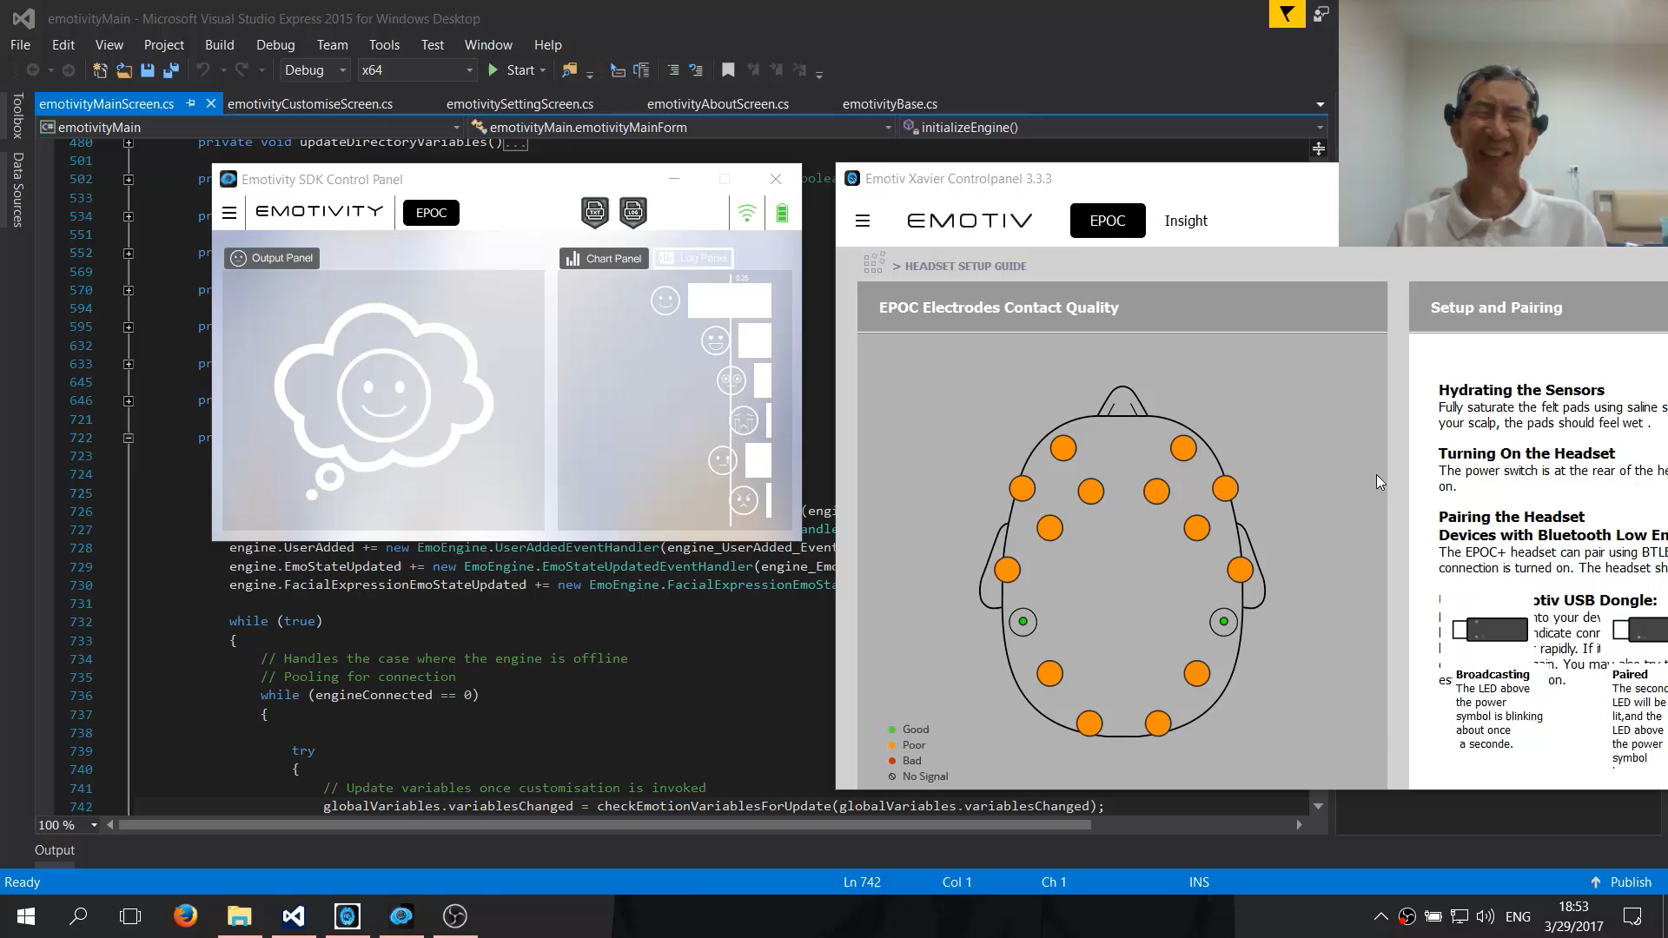
Headset in Action

Slide 33
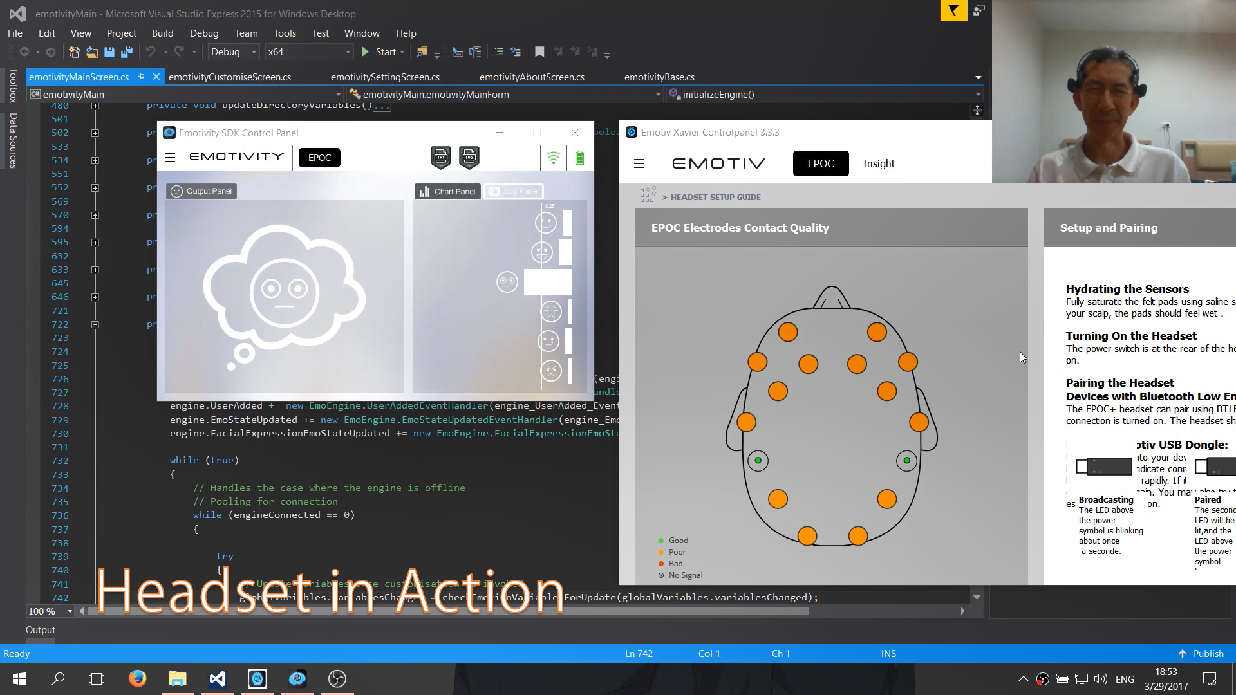

Slide 34
Solutions
Wait for an unlikely better headset and library.
Open source this, and hope for the best.
Any good solutions are welcomed.

Slide 35

Thank You for Your Attention

